Slide 1

People and Prompt Engineering Techniques

Slide 2

1 Advanced Prompting Strategies for Language Models

Slide 3

Zero-shot prompting for immediate task execution
Normal Prompting Approach
This is a normal subtitle content example, demonstrating a standard approach to information presentation within the given constraints and guidelines for clarity.

Slide 4

Few-shot learning with minimal example demonstrations
Human-like Learning Efficiency
Standard Learning Method
This method mirrors human ability to learn new concepts quickly from limited exposure, making models more adaptable and responsive to novel scenarios.
This is a normal subtitle content example, demonstrating a standard approach to information presentation within the given constraints and guidelines for clarity.
20xx
20xxx
20xx
20xx
Adaptive Prompting Framework
Efficient Learning with Examples
Few-shot learning is a crucial advanced strategy, enabling models to adapt rapidly to specific task requirements with minimal data, enhancing versatility.
Few-shot learning allows models to generalize from a small number of examples provided in the prompt, significantly improving performance on new, related tasks.

Slide 5




Chain-of-Thought for complex reasoning pathways
Typical Reasoning Flow
Structured Reasoning Process
Cognitive Process Emulation
This is a normal subtitle content example, demonstrating a standard approach to information presentation within the given constraints and guidelines for clarity.
Chain-of-Thought prompting guides models to break down complex problems into intermediate steps, revealing their reasoning process and improving accuracy on intricate tasks.
This technique simulates human step-by-step reasoning, making the model's decision-making more transparent and reliable for complex problem-solving scenarios.

Slide 6

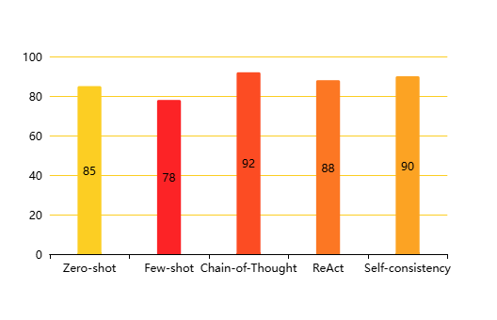
Prompt Engineering Techniques Overview
Effectiveness of Prompt Engineering Strategies(Effectiveness Score (%))

Slide 7
2 Interactive and Consistent AI Prompting Methods

Slide 8




ReAct prompting for dynamic action and observation
Normal AI Interaction
ReAct in Prompt Engineering
Normal AI interaction involves standard input-output processes, often lacking the dynamic reasoning and action capabilities seen in advanced prompting techniques.
ReAct combines reasoning and acting, enabling models to perform dynamic actions and observations for complex problem-solving. This enhances interactive AI capabilities.
Interactive AI Prompting
ReAct is a key interactive AI prompting method, facilitating dynamic action and observation to achieve more sophisticated and context-aware responses from models.

Slide 9



Self-consistency for robust and reliable outputs
63%
75%
87%
Self-Consistency in Prompting
Normal Output Reliability
People and Reliable AI
Self-consistency enhances output reliability by generating multiple reasoning paths and selecting the most frequent answer, ensuring robust model performance.
Normal output reliability refers to the standard consistency of AI responses, which may not always achieve the high robustness of self-consistency methods.
People require reliable AI outputs for critical applications. Self-consistency provides a method to ensure the robustness and trustworthiness of AI-generated content.

Slide 10
Enhancing model performance through iterative prompting
Iterative Prompting for Performance
People and Enhanced AI
Interactive Prompting Methods
Iterative prompting, including techniques like Chain-of-Thought, enhances model performance by refining responses through sequential reasoning steps, leading to better outcomes.
People benefit from enhanced AI performance, as iterative prompting techniques lead to more accurate and nuanced responses, improving the utility of AI systems.
Iterative prompting is an interactive AI prompting method that significantly enhances model performance by guiding the AI through a series of refined steps and considerations.

Slide 11
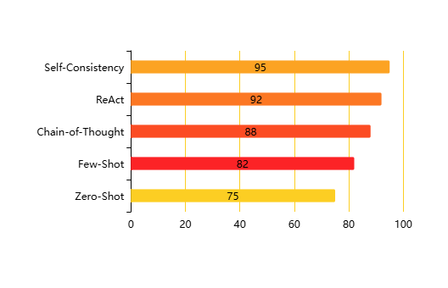
Prompt Engineering Techniques Effectiveness
Effectiveness of Prompt Engineering Strategies(Effectiveness Score (%))

Slide 12
THANK YOU

